Slide 1
Distributed Control and Automation Framework (DCAF)
Designing an Application with DCAF
Benjamin Celis, Mathew Pollock, Simon Perez

Slide 2
Agenda
What should be a module?
How many Modules do I need?
Interacting with code outside the engine

Slide 3
What should be a Module?

Slide 4
What Should be a Module
Modules should operate on latest value (Tag) data
They should generate new values, modify existing values, or route values
Communicating stream data between modules may not be a good fit

Slide 5
What Should be a Module
Application Specific vs Reusable
Application Logic could be within a module or outside of DCAF
Consider making a module into a state machine for control
Remember the state machine should not block
Do not hold state data in the module unless there can be only one instance

Slide 6
How many modules?
If two modules must always be used with each other, consider combining them.
Engine
Engine
Custom Input Module 1
Custom Process Module 1
Scan Engine Module
Custom Input And Process
Scan Engine Module
Outside
Outside
Outside
Outside

Slide 7
How many modules?
If multiple combinations are possible, keep them separate
Engine
Custom Input Module 1
Custom Process Module 1
Scan Engine Module
Shared Memory Module
Custom Process Module 1
Outside
Outside

Slide 8
How many modules?
If multiple configurations are possible, consider keeping them separate

Slide 9
CVT

Slide 10
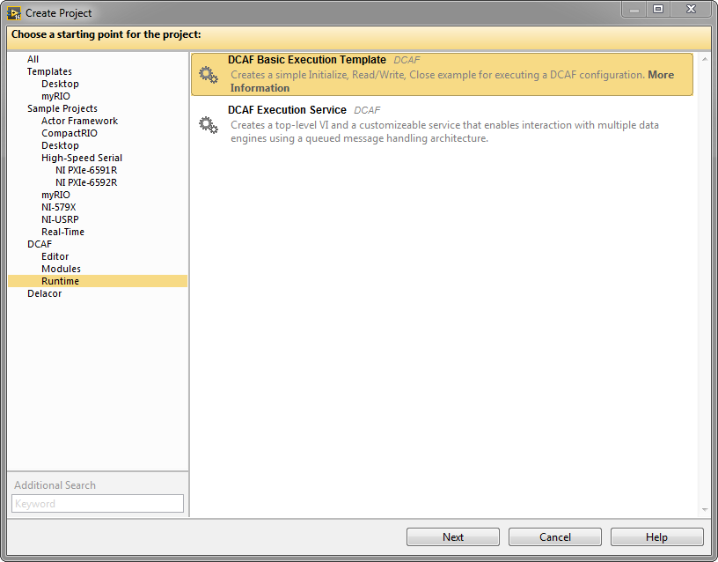
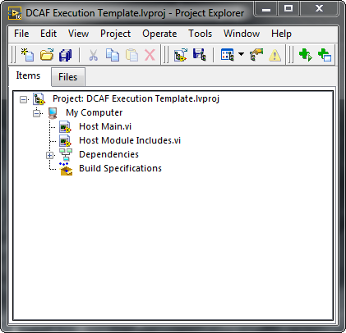
DCAF Project Templates
Notes:
Application templates exist in addition to the plugin templates.

Slide 11
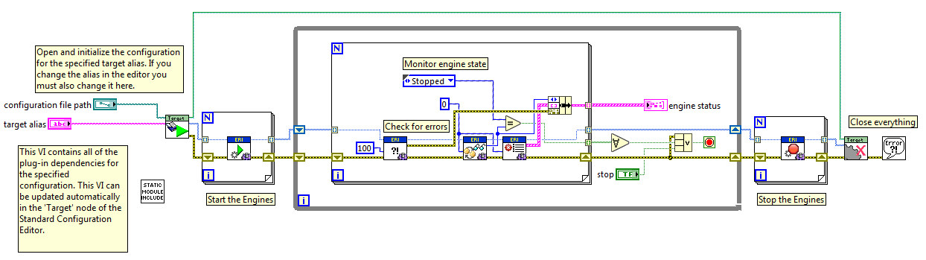
Running the Configuration

Slide 12
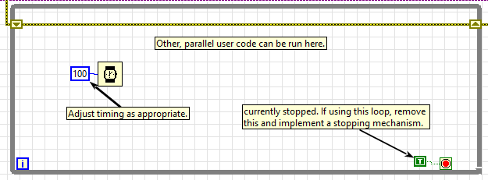
Coding outside DCAF
Example loop from the project template
Only need to call the engine and check, other code can run alongside as needed

Slide 13
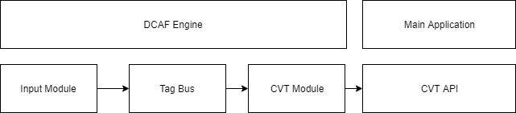
Coding outside DCAF - CVT

Slide 14
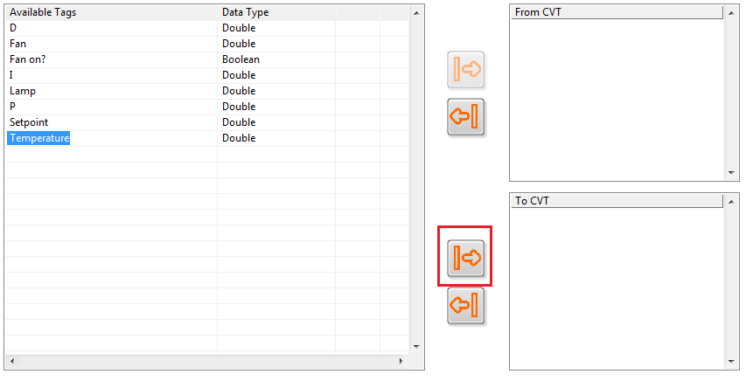
Coding outside DCAF - CVT
To get Tag Data out of DCAF into the same main application, use CVT
Pass the Tag to the CVT Module

Slide 15

Coding outside DCAF - CVT
Read the Tag with the CVT API
Use the Tag data in your application

Slide 16
Shared Memory

Slide 17
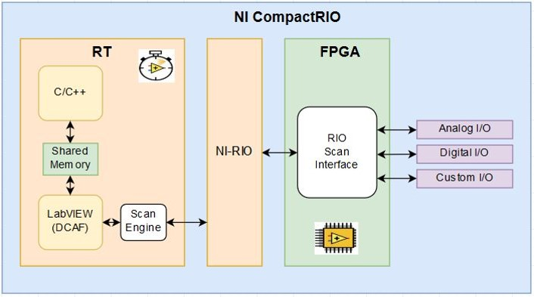
Shared Memory
DCAF can access Linux Shared Memory through a standard Module
Tags can then be accessed from LabVIEW or other languages

Slide 18
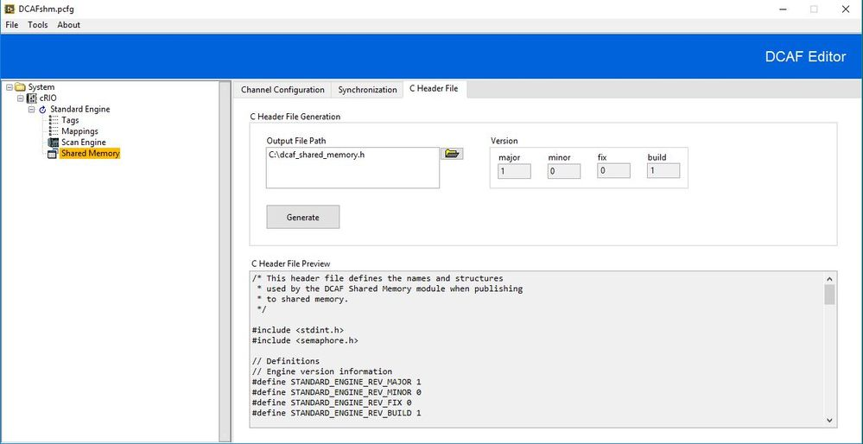
Shared Memory
Notes:
Application templates exist in addition to the plugin templates.

